Slide 1
2019 Popcorn Kickoff
Notes:
Alex Behrend
Pledge
Welcome to the group – thank you for being here.
Goal this year is 3.3 million dollars!! We can do it!!
Excited to role out some changes this year, but mostly keep the unit adventures coming.
Questions will be answered at the end of the training

Slide 2
Impact of Popcorn
$1,083,702 million dollars in unit commission straight to participating units!
Countless amazing experiences for our Scouts
1 million dollars used to re-invest in our Council – Camp improvements, program expansion, Camperships awarded

Slide 3
2019 Top Sellers!
CONGRATULATIONS!!!!
Pack 3940 in Lakeshore District – Patti Finlan, Unit Kernel - $43,605
Troop 1173 in Voyageur District – Misty Mrotek, Unit Kernel - $17,310

Slide 4
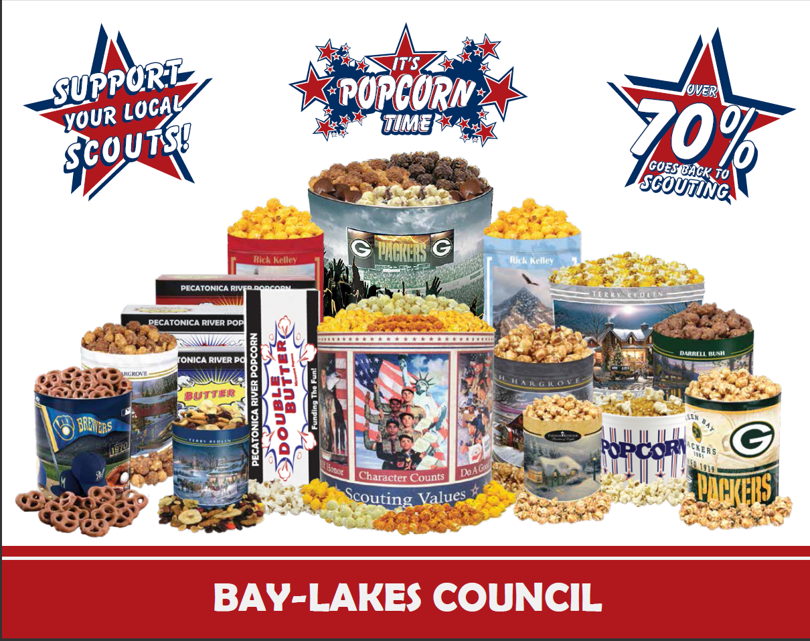
What
Notes:
Nick

Slide 5
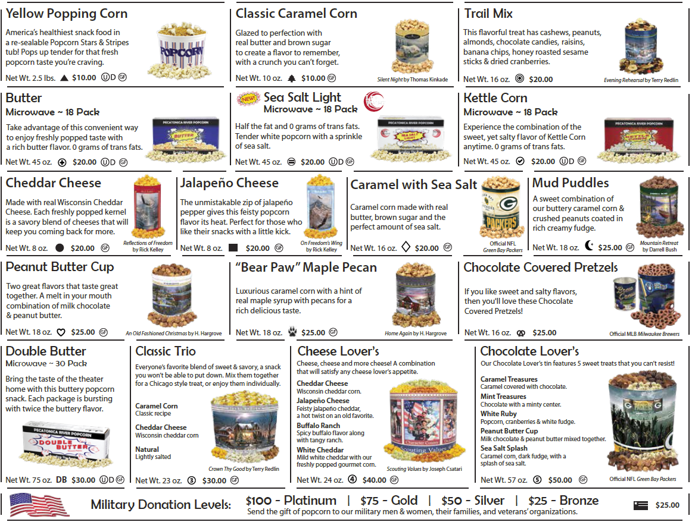
What
Notes:
Nick

Slide 6
Where To Sell
Show & Sell
Setting up a display of your popcorn at a high traffic area is an easy way to increase your sale!
Show & Deliver
Combines the Show & Sell (Products ordered in advance) and Take Order (Going door-to-door). One Stop Selling!
Take Order
The traditional way for Scouts to sell popcorn is going door-to-door in the community. Customers place their order on the take order form and it gets delivered after the sale.
Online Sales
Customers can support Scouts from across the country with prpopcornstore.com. Each Scout gets credit for what is sold.
Notes:
Alex –
New this year!! We have great partnerships with Festival and Roundy’s! They have asked the me to organize the Show and Sell dates because we were so excited thei managers where overwhelmed with calls. I will be setting up sign genius’ for the sale options. It will be a Scouts Honor, but I will confirm with the units to let you know when you have a confirmed date. For Festival, you will need to bring with you the cart contract to the store the day you sell. The links will go live on Tuesday night at 7pm. I will send communication out on Tuesday with the link to the page.
Remember – we are Scouts and helpful to one another. So, if you can’t make a date you have originally signed up for, communicate with me so I can send a note to everyone to fill the slot.
New this year! We have also formed a partnership with Fleet Farm and they are excited to have Scouts selling popcorn outside the stores this year. We just firmed up the partnership on Friday, I will communicate with you the contact person for each store to set times up to sell with them.

Slide 7
Where: PRPopcornstore.com
Online selling allows Scouts to sell to faraway friends and family.
Why sell online?
No deliveries! PRP ships the product directly to the consumer.
Emails sent out each time an order ships so that the unit leader and Scout can track sales.
It’s easy! Scouts register to sell with their unit leader via the Unit dashboard.
Online Options
Sales count towards prize levels.
New for 2019
Free Shipping on all online orders.
Notes:
Alex –
This is a major opportunity for growth for the Council and it is improved this year! This year is FREE Shipping!!!!! The best part about online sales is – you the kernel never has to pick it, inventory it, delivery it or even see it ☺

Slide 8
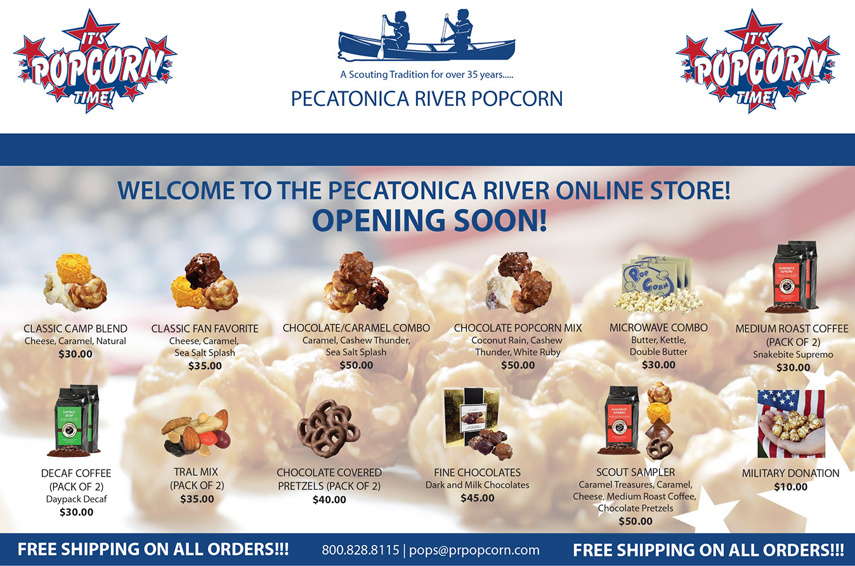
Where: PRPopcornstore.com
Notes:
Alex – different product line up to keep it fresh!

Slide 9
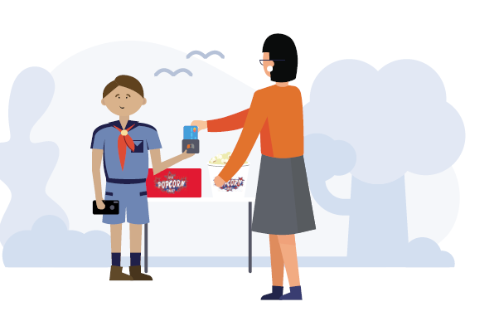
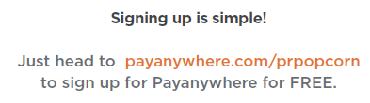
Where To Get Card Reader
Pecatonica River Popcorn is pleased to announce that we’ve partnered with mobile payments leader Payanywhere to help you increase your Unit’s popcorn sales with the very latest in point of sale software.
It’s FREE – Get your free credit card reader at payanywhere.com/prpopcorn.
Just 2.69 percent per swipe.
Notes:
Nick

Slide 10
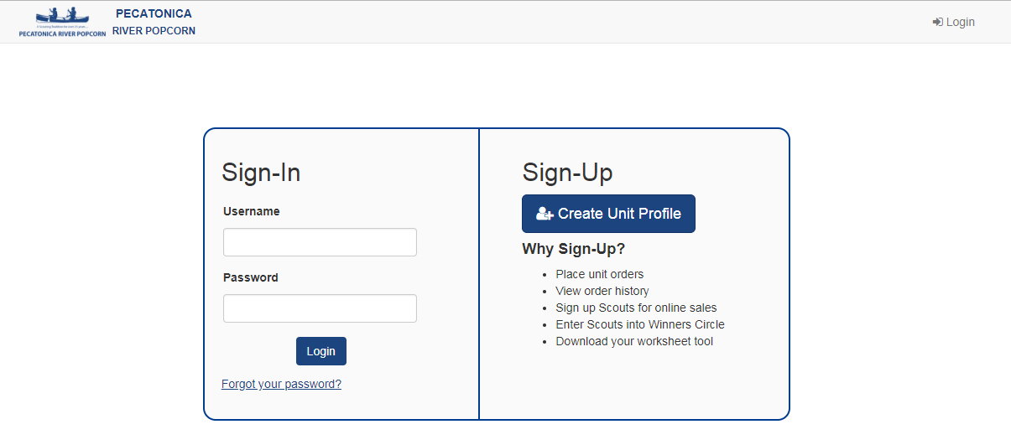
Scout Boss
www.pecatonicariverpopcorn.com
Notes:
Nick

Slide 11
Scout Boss
Creating a New Unit Profile
Only used if Unit has never sold popcorn before
Council Key: 635BLC
Notes:
Nick

Slide 12
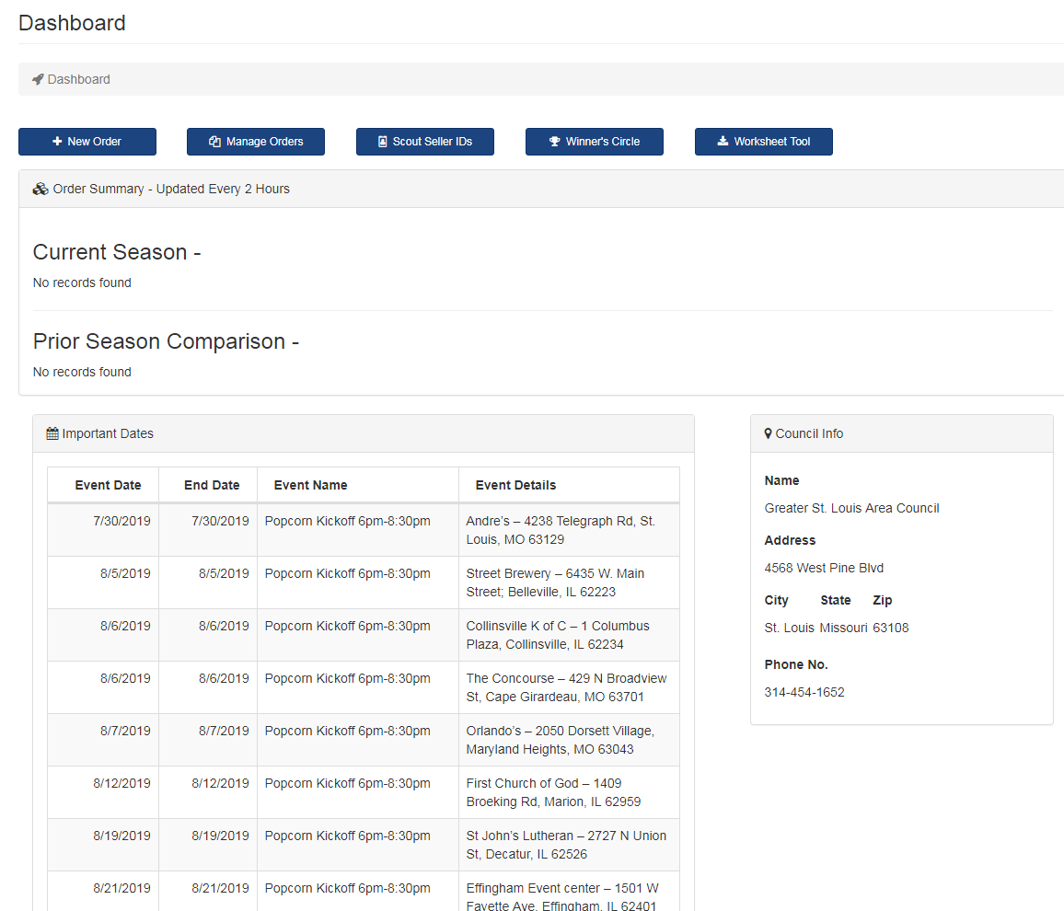
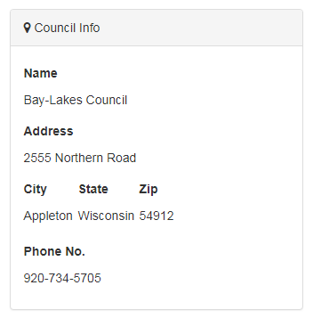
Scout Boss
Notes:
Nick

Slide 13
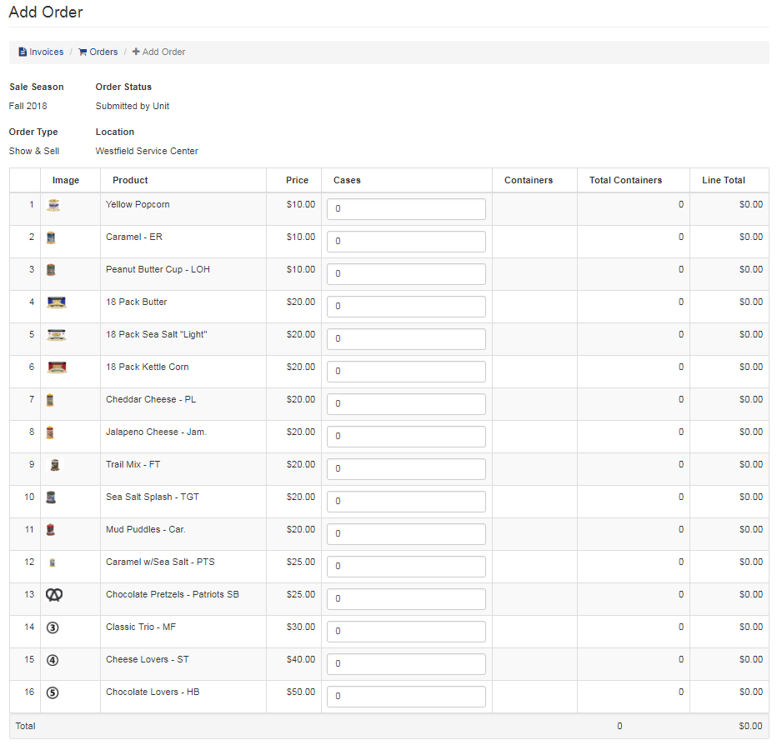
Scout Boss
Entering an Order
Show-N-Sell orders are ordered in cases only.
Take Orders are ordered in containers only.
You have the ability to edit your order by logging into your unit profile up until the council approves the order.
Notes:
Nick

Slide 14
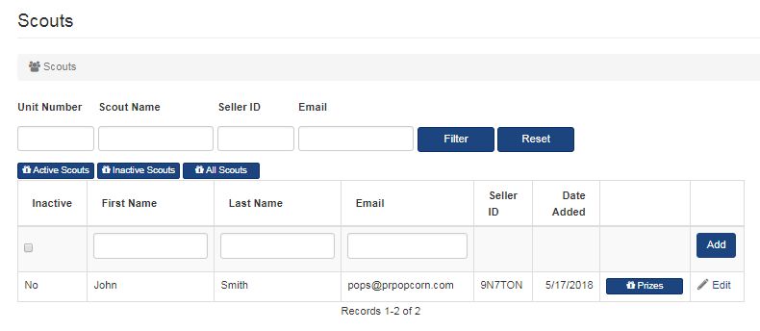
Scout Boss
Adding a Scout for a Seller ID
Notes:
Nick

Slide 15
Scout Boss
Entering a Winner’s Circle Prize
Notes:
Nick

Slide 16
(Check it Out!)
Notes:
Nick

Slide 17
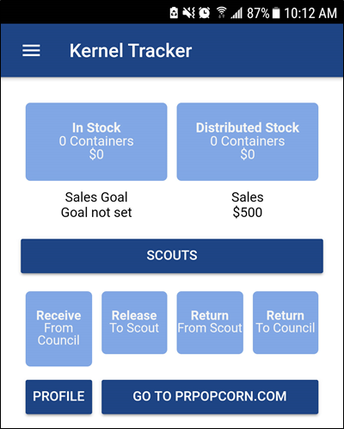
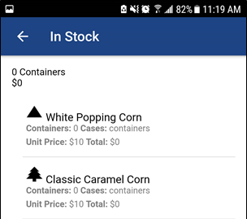
www.PRPopcorn.com
www.PRPopcorn.com
Kernel Tracker App
Kernel Tracker helps you easily manage Show & Sell inventory down to the individual container:
Product Received from Council
Product Given to Scouts
Product Returned by Scouts
Product Returned to Council.
You can even see exactly what products each Scout has checked out and how much they owe.
Notes:
Nick

Slide 18
Kick off
Tasting
Kit
Scout Tasting Session
The purpose of a tasting session is to have each boy try 1 or 2 kernels of each flavor. Once everyone has tasted each flavor, have the boys vote on which popcorn they liked best! By conducting a tasting session for your group you create product familiarity and product knowledge. Now each scout can use the tasting results as a selling tool
Organize a sale timeline from within the Council timeline that best fits your unit’s potential and calendar
Assign goals down to each individual den/patrol and Scout
Relay the unit’s plan to all Scouts, leaders, and families – connect the sales goal to the unit budget
Notes:
Patti

Slide 19
Kick off
Notes:
Patti - Go through bag

Slide 20
Kick off
Notes:
Patti

Slide 21
Kick off
Only 44% of parents say their
Scout set a sales goal.
Scouts who set a goal sell twice as much.
Setting a goal is critical to each Scout’s and units success
Notes:
Patti - Any other ideas or pictures Patti has of her own kick off and testimony on goal setting

Slide 22
Commission Stuture
30% - TOTAL BASE COMMISSION
25% - TOTAL BASE COMMISSION
5% - ATTEND TRAINING**
Total
Possible
41%
BONUS Up to 8%***
3% $325 per Scout average
5% $500 per Scout Average (or $20,000)
Option – 3% Cash over Prizes
Notes:
Jason Flanner

Slide 23
Who – BSA Prize Program
Notes:
Jason Flanner - Keller Prize – explain the difference of doing extra commission or the Keller Prize program. They were prize forms attached to all order forms.

Slide 24
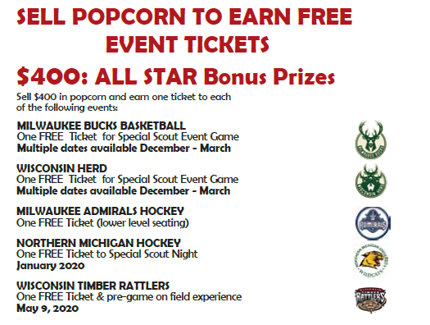
Bonus Prizes
Popcorn Sale Patches – Any Scout who sells
$100 or more in popcorn will receive a popcorn sales patch.
Notes:
Jason Flanner
Bonus Prizes – ALL Scouts are eligible
Patch – this year the patch will build on itself to make a light saber – there will be a button loop on the main patch and grow from there.
We are again doing the All Star Bonus prizes – new this year is the Oshkosh Herd Basketball team as an addition

Slide 25
Bonus Prize
Notes:
Jason Flanner
Mark your calendars – December 21st for the Star Wars movie premier! We will have at least 2 Star Wars characters at each location to interact with Scouts!! This is exciting stuff!! Encourage your Scouts to get excited and take advantage of this fun event!
New this year! For ever $1,000 a Scout sells, they will have the opportunity to win a $250 Amazon Gift Card!!! So the more you sell, the more chances they have to win! Winner will be announced November 15, 2019.

Slide 26
Bonus Prize
Online sales count for prizes!
Any Scouts that sell $2,500 or more can have their choice of prize from Pecatonica River’s “Winners Circle”. Unit leader will enter their Scout’s into the Winners Circle.
Any Scouts that sell $4,000 or more can have their choice of prize from Pecatonica River’s 3 prize options
Notes:
Jason Flanner

Slide 27
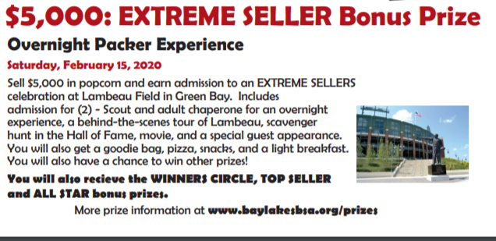
Bonus Prize
Notes:
Jason Flanner
New this year!! Do you want to stay overnight at Lambeau Field!! Now if your chance! For every $5000 a Scout sells, they get overnight stay for 2 in the Atrium at Lambeau, including a behind the scenes tour, scavenger hunt, movie and a special guest appearance!

Slide 28
Bonus Prize
PRIZE
PROGRAM
BONUS
PRIZES
One Prize Program for all Scouts – Keller
OR – 3% Cash Over Prizes
ALL SCOUTS ARE ELIGIBLE –
Sales totals are entered on
Individual Sales Report form
Notes:
Jason Flanner

Slide 29
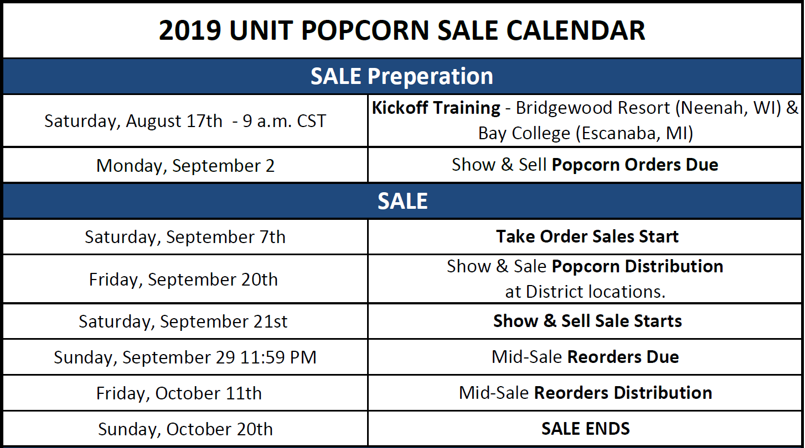
When - TIMELINE
Notes:
Wendy

Slide 30
When – Open Warehouse Hours
WOW Logistics – Appleton 4:30-7:30
September 26, October 3 and 17
Sheboygan County Food Bank -4:00-5:00
September 25, October 2, 16
Notes:
Wendy
Any unit can show up anytime within the designated times above to pick up or return product they need to keep stock for show and sell. No appointments needed!

Slide 31
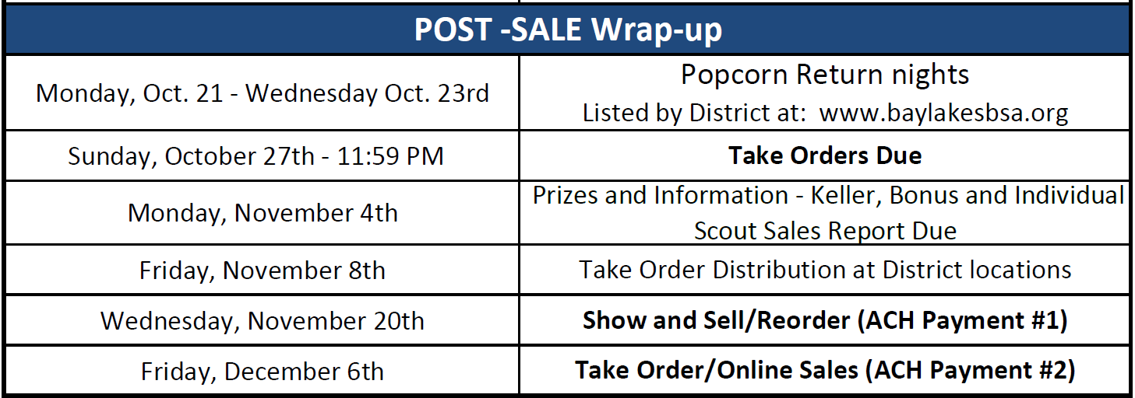
When - TIMELINE
Notes:
Wendy

Slide 32
Unit Kernel Incentive
Notes:
Alex
That’s right! IT’s back. I know how hard each of you work in this room to bring amazing program to 1000’s of Scouts and families and sometimes goes unnoticed. I want to make sure you get rewarded too!! So, if your unit hits your unit goal, which is listed on your sheet in your materials bag, you will receive this pull over as a reward for yourself! That’s right – you will get to show off with prideall the hard work and success you were able to lead your unit to!

Slide 33
New This year - recap
Flashlights for making 5 asks!!
Unit Kernel Incentive
Open Warehouse Hours
No Chocolate Returns
Credit Card Reader
Lambeau Overnight Experience
www.baylakesbsa.org/popcorn
Festival and Roundy’s show and sell sign up
Fleet Farm Partnership
Notes:
Alex
Flashlights – this is for our Cub Scout packs – we have a lot of new families join I the fall and know some of them are hesitant on even asking people to help support popcorn. We wanted to have an instant recognition for those Scouts that make 5 asks – so each Cub Scout pack has flashlihgts in their bags!
Kernel incentive – brought it back! If you meet your goal, you get a super cool pull over!
Open warehouse hours – this isn’t exactly new, but wanted to hightlight it again this year!
No Chocolate Returns – last year we had a lot of units bring back chocolate product that was returned and then redistributed to customers and it was melted. So, when your unit orders chocolate it is yours to keep!
Card reader – don’t forget your unit can get a free cc reader!
Packer Experience bonus prize – How much fun is this!!!!!!! Your Scout can earn the opportunity to stay the night at Lambeau Field!!!!!!!!!!!!!!!!

Slide 34
Big Goals – Big Results
Notes:
Jason Wolf

Slide 35
Thank You!
Questions or Comments?

